Slide 1

Selected ISO
Human-Computer Interaction/ Usability Standards
Paul Green
University of Michigan

Slide 2
Part 1: ISO 9241

Slide 3
To get to ISO ergonomics standards (Ergonomics TC)
ISO.org > Taking part > Who develops standards > Technical Committees
Scroll to and click on: ISO/TC 159 Ergonomics
Click on: Work programme (under Quick links)
Scroll to & click on: ISO/TC 159/SC 1 General ergonomics principles
or ISO/TC 159/SC 4 Ergonomics of human-system interaction
OR
iso.org/committee/53372/x/catalogue/

Slide 4
This presentation will inform you about the fundamental
ISO standards and technical report related to the the design of devices, equipment, systems, and facilities for human use.
Other names commonly for this topic include
Human factors
Human-factors engineering
Usability
Many other relevant ISO documents than those identified here

Slide 5
The ergonomics of human-computer interaction are
in ISO 9241 managed by ISO Technical Committee 159
Original title: Ergonomic requirements for office work
with visual display terminals (VDTs), structure below (9241-x)
1: General introduction
2: Guidance on task requirements
3: Visual display requirements
4: Keyboard requirements
5: Workstation layout & postural requirements
6: Guidance on the work environment
7: Display requirements with reflections
8: Requirements for displayed colors
9: Requirements for non-kb input devices
10: Dialogue principles
11: Guidance on usability
12: Presentation of information
13: User guidance
14: Menu dialogues
15: Command dialogues
16: Direct manipulation dialogues
17: Form filling dialogues
20: Access. guidelines for
ICT equip. & services

Slide 6
ISO 9241 standards were split and expanded to a 3 digit sequence.
100 series: Software ergonomics
200 series: Human-system interaction processes
300 series: Displays and display related hardware
400 series: Physical input devices - ergonomics principles
500 series: Workplace ergonomics
600 series: Environment ergonomics
700 series: Application domains - Control rooms
900 series: Tactile and haptic interactions

Slide 7
There are currently >30 parts to ISO 9241, a number that is increasing.
Part 100: Introduction to standards related to software ergonomics
Part 110: Dialogue principles
Part 112: Principles for the presentation of information
Part 125: Guidance on visual presentation of information
Part 129: Guidance on software individualization
Part 143: Forms
Part 151: Guidance on World Wide Web user interfaces
Part 154: Interactive voice response (IVR) applications
Part 161: Guidance on visual user interface elements
Part 171: Guidance on software accessibility
Part 210: Human-centred design for interactive systems

Slide 8
Part 300: Introduction to electronic visual display requirements
Part 302: Terminology for electronic visual displays
Part 303: Requirements for electronic visual displays
Part 304: User performance test methods for electronic visual displays
Part 305: Optical laboratory test methods for electronic visual displays
Part 306: Field assessment methods for electronic visual displays
Part 307: Analysis and compliance test methods for electronic visual displays
Part 308: Surface-conduction electron-emitter displays (SED)
Part 309: (TR): Organic light-emitting diode (OLED) displays
Part 310: (TR): Visibility, aesthetics and ergonomics of pixel defects
Part 333: Stereoscopic displays using glasses
Part 391: Requirements, analysis and compliance test methods
for the reduction of photosensitive seizures
Part 392: Ergonomic recommendations for the reduction of visual fatigue
from stereoscopic images

Slide 9
Part 400: Principles and requirements for physical input devices
Part 410: Design criteria for physical input devices
Part 420: Selection of physical input devices
Part 910: Framework for tactile and haptic interaction
Part 920: Guidance on tactile and haptic interactions
Part 940: Evaluation of tactile and haptic interactions
Part 960: Framework and guidance for gesture interactions

Slide 10

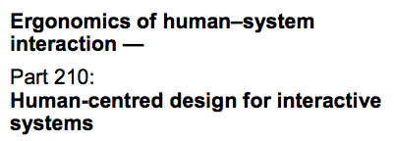
2010
18 references
32 pages

Slide 11
Although quite general, ISO 9241-210 provides a useful framework.
Note: For this and subsequent standards, the front matter
(e.g., foreword, introduction, scope) are not shown to save space.

Slide 12
Defines key terms used in other 9241 documents
(originally from 9241-11) - examples
Goal – intended outcome
Task – activities required to achieve a goal
Effectiveness – accuracy and completeness with which users achieve specified goals
Efficiency – resources expended in relation to the accuracy and completeness with which users achieve goals
Satisfaction – freedom from discomfort and positive attitudes toward the use of the product
Usability – extent to which a system, product, or service can be used by specified users to achieve specified goals with effectiveness, efficiency, and satisfaction in a specified context of use

Slide 13
ISO 9241-210 offers 7 reasons for adopting human-centered design.
Increase user efficiency/productivity and organizational operational efficiency
Reduce training and support costs (if easier to use)
Increase accessibility to a wider range of users (if easier to use)
Improve user experience
Reduce discomfort and stress
Provide a competitive advantage (improve brand image)
Enhance sustainability

Slide 14
ISO 9241-210 list 6 principles of human-centered design.
Development
is based on understanding users, tasks, and environments
involves users in the process
is based on user-centered evaluation
is iterative
addresses the whole user experience
uses a multidisciplinary, multi-perspective team
Wording is revised for clarity and conciseness

Slide 15
ISO 9241-420 is an example of the more specific parts of ISO 9241.
2011
9 references
106 pages

Slide 16
The description of selection methods in 420 is quite detailed.

Slide 17
The Annexes provide specific assessment methods for various input devices.

Slide 18
There are a number of specific definitions in 9241-420
mostly from ISO 9241-400.
Dragging, dragging and dropping
Moving 1 (or more) objects on a display by translating it along a path determined by a pointer
Pointing
Operation with a graphic user interface in which an input device is used to move a small display image (such as a pointer) to a specific location on the display
Device names:
joystick, displacement joystick, puck, tablet
Keyboard terms:
home row, home row height, keyboard profile, keyboard slope, key rollover

Slide 19
The selection objectives can be quite varied (examples).
Compare devices for some application (mouse A vs. B)
Evaluate a device for a new task not in the original context of use
(keyboard as a pointing device) or as a replacement (trackball vs. joystick)
Determine minimum/optimum characteristics of a device for a task
(size of a tablet)
Determine workplace requirement (size and shape of support surfaces
for input devices)
Determine desired settings for input devices (filtering to eliminate jitter)

Slide 20
Somewhat unusual, is their definition of the Index of Difficulty
(for Fitts Law).
Index of difficulty = measure of the user precision required in a task (in bits)
For selection, pointing, and dragging tasks:
For tracing tasks:
where:
d = distance of movement to the target
w = target width of the displayed target along the approach axis for selection,
pointing, or dragging tasks and perpendicular for tracing tasks

Slide 21
9241-420 provides tables of selection criteria
(e.g. usability)

Slide 22
Annex B tracing test for freehand input involves tracing circles.
Measure deviation to nearest mm, time to 0.1 s
100 mm diameter

Slide 23
Annex C, the dragging test, involves moving dots into circles.
Score position to nearest mm,
Time to nearest ms
8 mm diameter dots, 10 mm diameter circles, 100 mm move
Repeat 10 times for each direction

Slide 24
Annex D is an assessment of comfort using 12 rating scales.

Slide 25
The rating scales are divided into 2 categories, general and fatigue.
General
Actuation force
Operation smoothness
Operation effort
Accuracy
Operation speed
General comfort
Overall operation
Fatigue
Finger fatigue
Wrist fatigue
Arm fatigue
Shoulder fatigue
Neck fatigue

Slide 26
Points Effort
A Borg CR10 scale (1982)
is used to separately rate
arm, shoulder, and neck effort.

Slide 27
Annex E describes a 1-direction tapping test.
d =
movement
distance
Low I_{D} =< 4
4 < Medium I_{D} =< 6
High I_{D} >6
w =
target
width
Measure time (ms)
error (to 1 mm)
Alternatively tap 25 times

Slide 28
Annex F describes a
multi-directional
tapping test.
Vary target size,
movement distance
Measure time (ms)
error (to 1 mm)

Slide 29
Annex G is for assessing hand-held keyboards (e.g., mobile devices).
Enter text and data
for up to 3 min.
Samples ->
See 9241-420
for more.
Record time
& errors.

Slide 30
Annex H contains extensive tables to aid in device design.
Example: compact keyboards
Property Specification
Also info on
force/displacement,
feedback, legends,
slope, surface gloss, etc.
Similar info for
Full-size keyboards

Slide 31
There are also specifications for joysticks (part of 1 of several tables).
Property Specification

Slide 32
There are also specifications for touchpads (part of 1 of several tables).
Property Specification

Slide 33
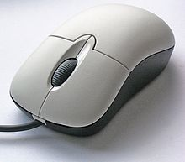
The coverage and detail of 9241-420 is extensive, including:
mice
trackballs
styli & light pens
touch screens
pucks
tablets/overlays
https://upload.wikimedia.org/wikipedia/commons/thumb/2/22/3-Tasten-Maus_Microsoft.jpg/330px-3-Tasten-Maus_Microsoft.jpg
https://pisces.bbystatic.com/image2/BestBuy_US/images/products/9765/9765259_sa.jpg
https://ae01.alicdn.com/kf/HTB1D.D9QpXXXXa9XFXXq6xXFXXXh/Original-teclast-x3-plus-tablet-pc-Active-stylus-Special-stylus-pen.jpg_640x640.jpg
https://i.ytimg.com/vi/YmrNGOpzQVQ/hqdefault.jpg
http://teks.co.in/site/blog/wp-content/uploads/2016/10/36_touch_trend.jpg
https://ss7.vzw.com/is/image/VerizonWireless/apple_ipad_pro_new_12_9_spgry?$png8alpha256$&hei=410

Slide 34

Part 2:
Systems and software Quality Requirements and Evaluation (SQuaRE)
https://www.easycalculation.com/area/images/big-square.gif

Slide 35
To get to ISO JTC1 standards (User Interface)
ISO.org > Taking part > Who develops standards > Technical Committees
Scroll to and click on: ISO/IEC JTC 1 Information technology
Click on: Work programme (under Quick links)
Scroll to and click on: User Interfaces
OR
iso.org/committee/45382/x/catalogue/
https://upload.wikimedia.org/wikipedia/commons/thumb/e/e3/ISO_Logo_%28Red_square%29.svg/330px-ISO_Logo_%28Red_square%29.svg.png

Slide 36
ISO/IEC JTC 1 – Information Technology has developed 3180 standards
for MPEG, smart cards, and data base and programming languages.
SC 2 coded character sets
SC 6 telecomm
SC 7 software and systems engineering
SC 17 cards and security devices for personal ID
SC 22 programming languages
SC 23 digital media storage and interchange
SC 24 computer graphics and image processing
SC 25 IT equipment connection
SC 27 IT security
SC 28 office equipment
SC 29 coding of audio, picture, and multimedia
SC 31 automatic ID
SC 32 data management
SC 34 document description
SC 35 USER INTERFACES (81 stds)
SC 36 IT for education
SC 37 biometrics
SC 38 cloud computing
SC 39 sustainability
SC 40 IT service management
SC 41 IoT
SC 42 AI

Slide 37
Standards developed by ISO/IEC JTC1 concern:
Examples to show the range of topics
ISO/IEC 9995 – Keyboard layout (many parts)
ISO/IEC 10741-1 - Cursor control for text editing
ISO/IEC 11581 – Icons
ISOIEC TR 13066 – Interoperability with assistive tech.
ISO/IEC 14754 – Pen gestures
ISO/IEC 17549 – Menu navigation
ISO/IEC 24752 – Universal remote console
ISO/IEC 30122 – Voice commands

Slide 38
Many of the important user interface assessment standards
were developed by SC 7 (Software & Systems Engineering)
https://www.iso.org/committee/45086/x/catalogue/
8 pillars of system/software product from ISO 25010
See also ISO 9126

Slide 39
The ISO 25000 series are organized into 6 categories.

Slide 40
To support the development of quality systems and software, standards
were developed to support a common industry format (CIF) for usability processes
based on ISO 9241-210 (Ergonomics of Human-System Interaction) &
ISO/IEC 15288 (Life Cycle Processes for Systems & Software Engineering)
Context of Use
Evaluation
Results
USER
NEEDS
Derived
Requirements
Designed
Solutions

Slide 45

Usability
Framework
2010
30 pages
21 references
https://www.ontestautomation.com/wp-content/uploads/2016/08/framework.jpg

Slide 46
Usability
Framework

Slide 47
Usability
Framework
The human-centred design approach of ISO 9241-210 is well established and focuses specifically on making systems usable. Usability can be achieved by applying human-centred design and testing throughout the life cycle. In order to enable a human-centred design approach to be adopted, it is important that all the relevant usability information items are identified and documented. This identification and documentation enables the usability of a system to be designed and tested.

Slide 48
ISO 25060 brings forward many definitions and points
to other standards that follow. It is not apparent what else it does.
User
User experience
User interaction
User interface
User interface element
Usability testing
Usability walkthrough
Usability
Framework
Effectiveness
Efficiency
Goal
Satisfaction

Slide 49
Usability Test
Report
2006
54 pages
11 references
For an early version, see:
https://zing.ncsl.nist.gov/iusr/documents/cifv1.0.htm
For version 2.02, see
https://zing.ncsl.nist.gov/iusr/documents/cifv2.02.html

Slide 50
ISO 25062 covers in great detail what must be in a usability test report.
Usability Test
Report

Slide 51

The checklist and the template in the Annexes are easy to follow.
The usability test report title page must have…
Company name or logo
Identifier that it is in IOE/IEC 26062 CIF format
Product name and version
Who led test
Report date
Report author
Customer company name & contact
Contact for questions
Supplier name, phone #, email address, & mailing address
Usability Test
Report
Section
5.1
https://searchengineland.com/figz/wp-content/seloads/2018/04/checklist-800x531.png

Slide 52
The usability test report executive summary must have…
Usability Test
Report
Section
5.2
High level overview of test
Product name and description
Summary of method including # & type of subjects & tasks
Results with statistics (including central tendency)
Reason for & nature of test
Tables summarizing performance
Probability of differences, if any

Slide 53

Per ISO 25062, the usability test report
introduction must have…
Product description
Product name & version
Parts of product evaluated
Intended users
Assistance technologies supported
Reason for & nature of test
Environment in which it is to be used
User work supported
Usability Test
Report
Section
5.3
Test objectives
Objectives & areas
of interest
Function & components
with which subject interacted
Reason for focus
on product subset
http://gulsstudio.com/wp-content/uploads/2014/04/Company-introduction-720x300.jpg

Slide 54

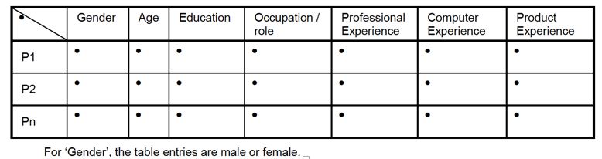
The usability test report methods section concerns participants
and the context of use. For participants, that includes …
Total number of participants tested
Segmentation of user groups
Key characteristics and capabilities
How selected
Differences between the sample and user population
Section
5.4
Usability Test
Report
https://cdn-images-1.medium.com/max/1600/0*KQRD2vJD9uTK42yk.png

Slide 55

The context of use includes tasks, the test facility, the computing environment, & test administration tools.
Tasks
What was used
Which scenarios were used
Why the tasks were selected
Data give relevant to tasks or scenarios
Completion criteria
Usability Test
Report
Section
5.4 (Method)
http://www.podiohelp.com/wp-content/uploads/2012/08/Podio-tasks-and-messages-e1346243525564-296x300.jpg

Slide 56
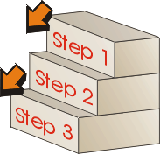
The experiment design includes the procedure, instructions, & usability metrics.
Procedure
Operation definitions of measures
Descriptions of independent and control variables
Time limits for tasks
Policies and procedures for subject interaction with experimenters
Sequence of events from greeting to dismissal
Details of NDA
Verification that subjects knew and understood their rights
Steps to execute the evaluation and record the data
Number and roles of those who interacted with subjects
If others were present in the test environment
If participants were compensated
Usability Test
Report
Section
5.4 (Method)
http://lrd.kangan.edu.au/toolbox1213/toolbox1213/topics/topic24/images/t24_02.gif

Slide 57

ISO 9241 standards divide usability “metrics” into 3 categories,
effectiveness, efficiency, and satisfaction.
Effectiveness = relates to achieving product goals of accuracy and completeness
% task completion, error frequency, frequency of assists,
use of help/documentation
Efficiency = effectiveness achieved relative to the quantity of resources expended
mean time to complete a task, time on task
Satisfaction = user’s subjective response when using a product,
ratings of satisfaction, usefulness, ease of use
examples: ASQ, CUSI, PSSUQ, QUIS, SUMI, SUS
http://topstepconsulting.com/wp-content/uploads/2016/02/8535544_s-e1454343152971.jpg

Slide 58
The usability test report results section includes tabular and graphical data
for all 3 classes of usability metrics.
Participant # | Measure 1 | Measure 2 | … | Measure N
1
2
…
N
mean
sd
min
max
Section
5.5
Usability Test
Report

Slide 59

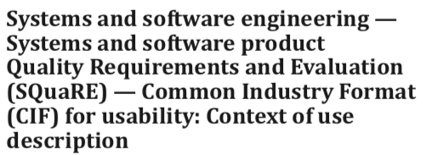
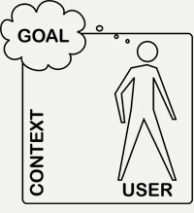
2014
34 pages
24 references
Context of Use
Report
http://www.ijdesign.org/public/journals/1/1515/Figure%201.jpg

Slide 60
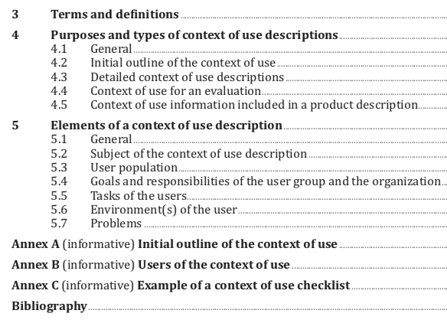
Context of Use
Report

Slide 61
Context of use (definition 3.2)
users, tasks, equipment (hardware, software, and materials), and the physical and social environments in which a system, product, or service is used
Context of Use
Report
Persona (definition 3.9)
Representation of a type of user that includes a concise summary of the characteristics of the user that is most informative to the design to make the persona a realistic character

Slide 62
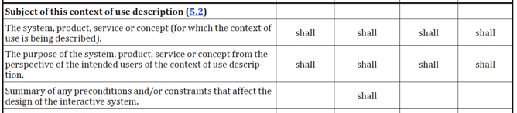
ISO 25063 describes in great detail what is to be contained
in each of the 4 applications of a context of use information.
Initial
Outline
Detailed
Description
in Eval
Report
in Product
Description
Subject (What is evaluated)
Context of Use
Report
Section 5.2

Slide 63
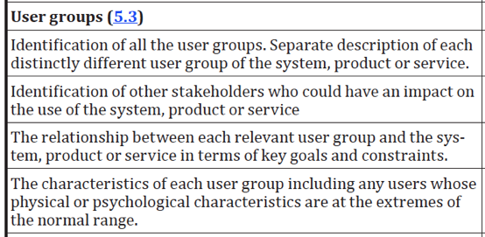
Context of Use
Report

Slide 64
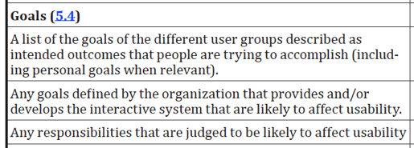
Context of Use
Report

Slide 65
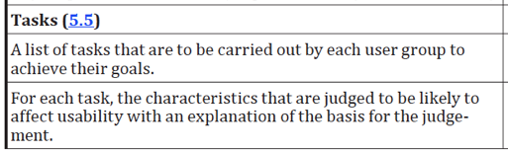
Context of Use
Report
Task attributes
Goal
Outcome
Frequency & importance
Input variability
Information needs
Potential negative consequences
Duration
Complexity
Method flexibility
Dependencies
Serial/parallel activities
Roles of those doing the task
Function allocation
Task load

Slide 66
The technology environment includes ….
Hardware (processor speed, memory, network connections ….)
Screen (resolution, color depth, number of monitors, sizes, ...)
Input devices
Software (browser version, OS version,...
Connectivity (hard wired vs. wireless, ..)
Assistive technology
Documentation
Personal protective equipment
Etc...
Context of Use
Report
- Environment (5.6) also includes social & physical

Slide 67

Problems (section 5.7) include trouble reports
from customer service, and information from user surveys, focus groups, and other sources.
Can be deficiencies in effectiveness, efficiency, or satisfaction
Examples in document help, but addition structure to organize them would be useful.
Context of Use
Report
http://carneyco.com/wp-content/uploads/2015/10/problem-solution2-300x227.jpg

Slide 68

Context of Use
Report
The Context of Use checklist in the Annex is helpful.
Example 1.1.1 – User types being considered
https://s3.amazonaws.com/checkli.com/avatars/blue-check.png

Slide 69

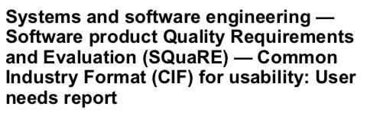
User Needs
Report
2013
32 pages
16 references
User need (definition 4.19)
Prerequisite identified as necessary for a user, or a set of users, to achieve an intended outcome, implied, or stated within a specific context of use
-> to coordinate team, develop requirements, audit trail

Slide 70
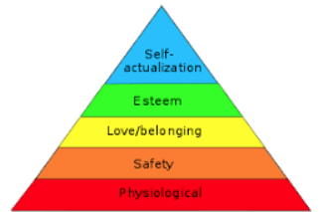
Terms and definitions
Purposes of a User Needs Report
5.1 General
5.2 User Needs Reports for existing products, services, and systems
5.3 User Needs Reports for new products, services, and systems
5.4 User Needs Reports for verifying, changing, and elaborating context of use
5.5 Relationship to other CIF information items
Content of a User Needs Report
6.1 Content elements
6.2 Initial indicators of the needs for a system/product/service or improvement
6.3 User responsibilities and goals
6.4 Source data on which user needs are based
6.5 Consolidated user needs
6.6 Recommendations (if appropriate)
6.7 Data collection methods/procedures
6.8 Supporting information
Annex A Users of User Needs Report
Annex B User Needs Report Format
User Needs
Report
https://upload.wikimedia.org/wikipedia/commons/thumb/3/33/MaslowsHierarchyOfNeeds.svg/450px-MaslowsHierarchyOfNeeds.svg.png

Slide 71
Each user needs statement needs to include ….
User Needs
Report
The user or set of users to which it applies
The intended outcome
What is needed to achieve the intended outcome
The context of use to which it applies
Example: An employee (user) needs to know how to obtain an access coded (need) to log onto their work computer (intended outcome) using the tax software (context of use)
This document is can be more difficult to apply
because there is less detail provided in some sections.

Slide 72

ISO/IEC
26065
24 pages
(CIF) for Usability: User requirements
specification
Under Development
https://www.clker.com/cliparts/P/l/C/p/n/c/work-in-progress-md.png

Slide 73
Evaluation
Report
2016
46 pages
19 references

Slide 74
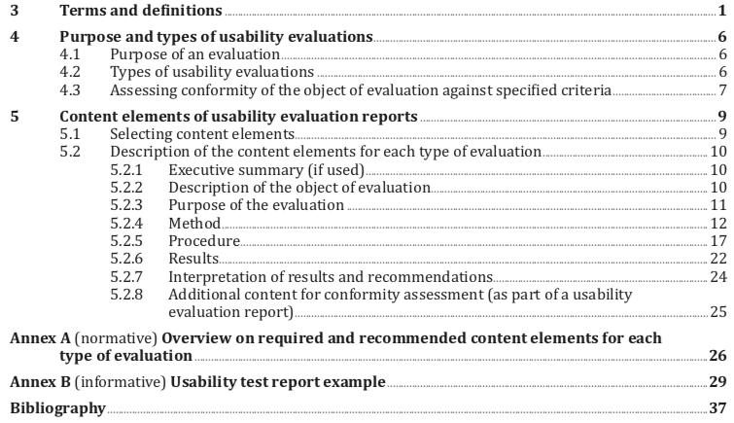
Evaluation
Report

Slide 75
Inspection-based evaluation (3.10)
Evaluation based on the judgment of 1of more evaluator(s) who examine
or use a system to identify potential usability problems
(including deviations from established criteria)
Usability defect (definition 3.17)
Product attribute(s) that lead(s) to a mismatch between user intentions
and/or user actions and the system attributes and behavior
Usability finding (definition 3.18)
Identified usability defect and/or usability problem
or positive usability-related attribute
Use error (definition 3.20)
User action or lack of user action while using the interactive system that leads to different results than that intended by the manufacturer or expected by the user
Evaluation
Report

Slide 76



Evaluation
Report
Usability evaluations include:
inspections to identify usability defects
& potential usability problems,
(2) observations of users (in actual settings),
(3) user surveys.
https://s3-us-west-2.amazonaws.com/rpmmultisite/wp-content/uploads/sites/150/2017/03/25150926/Inspection-150x150.jpg
https://cdn-images-1.medium.com/max/1200/1*ExM7r6VlIQSYBbL945NQkw.png
http://www.henrywurst.com/wp-content/uploads/employee-engagement.jpg

Slide 78

The purpose (5.2.3) can include:
Confirm/elicit user requirements
Identify usability defects and problems
Establish benchmarks
Measure level of usability (effectiveness, efficiency, satisfaction)
Test concepts
Pass/acquire certification
(25066 lists many more purposes)
Evaluation
Report

Slide 79
The methods section (5.2.4)includes:
Evaluation
Report
General | Type of evaluation used
 | Sufficient info to replicate the procedure used
Evaluators/participants | # of them
 | Segmentation of participants/evaluators
 | Key characteristics of those inspecting
 | Table of participants by characteristics
Tasks | Tasks used
 | Scenarios for each task & selection criteria
 | Source of tasks
 | Criteria for task completion & abandonment
Evaluation environment | Physical & technical environment & facilities
 | Evaluation tools
 | Evaluation administrators

Slide 80
The procedure (5.2.5) section includes:
Evaluation
Report
Design of the evaluation | Description of the evaluation design
 | Independent variables
 | Dependent measures (if used)
 | Predefined criteria for inspection or observation (if used)
 | Operation definition of measures & criteria
 | Interactions between those taking part
 | Others present (if any)
 | Instructions to participants
 | Sequence of activities
Data to be collected | Usability defects
 | Observed user behavior
 | User performance data
 | User reported data, qualitative & quantitative

Slide 81
The results can include …
Task performance, especially related to time | accuracy and completeness of task results (effectiveness)
 | task completion rate
 | time on task
 | efficiency
Errors and process measures | use errors and frequency
 | # of assists
 | # of mouse clicks, touch events, gestures
 | # of keystrokes
 | distance moved on screen with pointing device (e.g., mouse)
Eye tracking measures | e.g., fixation durations
Physiological data | e.g., skin conductance, blood pressure
Etc.
Evaluation
Report

Slide 82
If you need to apply any standard or guideline listed in these videos,
get (often purchase) the original.
The goal of this video series is to highlight the value of these standards and guidelines and encourage others to learn more about (and obtain) them. The coverage of each document is brief, and potentially, incomplete. If you are going to publish a paper or report, or design a product, or evaluate a system, you need complete knowledge of the relevant standards and guidelines, which means studying the originals.
Often, documents from ISO, SAE, ANSI, and others are not free. However, by not spending $100 to instantly obtain the full facts, a project with 1000 times the budget, could be jeopardized.
Paul Green

Slide 83
Those with questions should contact:
Paul Green
University of Michigan
Transportation Research Institute (UMTRI)
Driver Interface Group
2901 Baxter Road
Ann Arbor, Michigan 48109-2150 USA
Office: +1 734 763 3795
PAGreen@umich.edu
www.umich.edu/~driving

Slide 84
Thank you NIST for supporting development of these materials.
“This video was prepared by the University of Michigan under award 70NANB16H267 from the National Institute of Standards and Technology, U.S. Department of Commerce. The statements, findings, conclusions, and recommendations are those of the author and do not necessarily reflect the views of the National Institute of Standards and Technology or the U.S. Department of Commerce.”

Slide 85
Thank you NEXUS from Michigan Engineering
for supporting development of these videos.
Production of this recording was supported by the University of Michigan:
In support of the
Human Factors Engineering Short Course
(last week of July/first week of August each year)
For more information, Google
“U. of Michigan Human Factors Engineering Short Course”
”Center for Ergonomics”

